Slide 1
Cpu Scheduling Algorithm Summer Training Cse 443

Slide 2
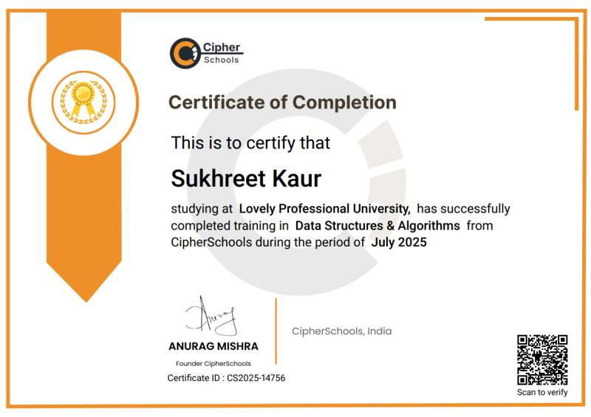
Certificate of Completion

Slide 3
Brief About the training and the project
Sharpened skills with the summer training by Cipher Schools
The Vision of the training was to enhance Handson experience in Data Structure and Competitive Programming
Title of the Project: CPU Scheduling Simulator using Data Structures
By: Sukhreet Kaur Language Used: Java
Algorithms Implemented:
FCFS (First Come First Serve)
SJF (Shortest Job First)
Priority Scheduling
Round Robin

Slide 4

Problem Statement
Problem Context: Modern operating systems handle multiple processes simultaneously. To ensure efficient CPU utilization, processes must be scheduled properly based on arrival, burst time, or priority.
Objective: To design a Java-based simulator that demonstrates and compares different CPU scheduling algorithms for better understanding of their performance and underlying data structures.
Challenge: Managing process execution order dynamically, similar to a real CPU ready queue.

Slide 5
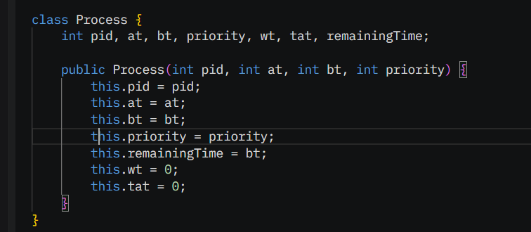
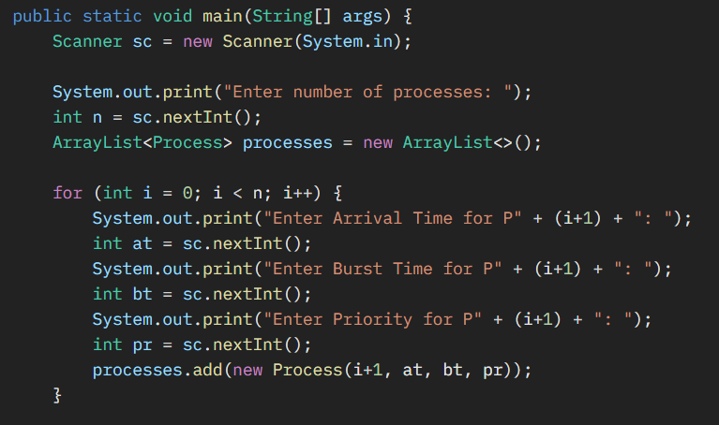
Core Structure
Step 1 — Code Structure:
Created Process class with pid, at, bt, priority, wt, tat, remainingTime.
Implemented separate functions for each scheduling method.
Applied sorting, selection, and queue manipulation per algorithm.
Step 2 — Core Computations:
Waiting Time (WT) = Start Time – Arrival Time
Turnaround Time (TAT) = Completion Time – Arrival Time
Average WT and TAT computed for overall efficiency.

Slide 6
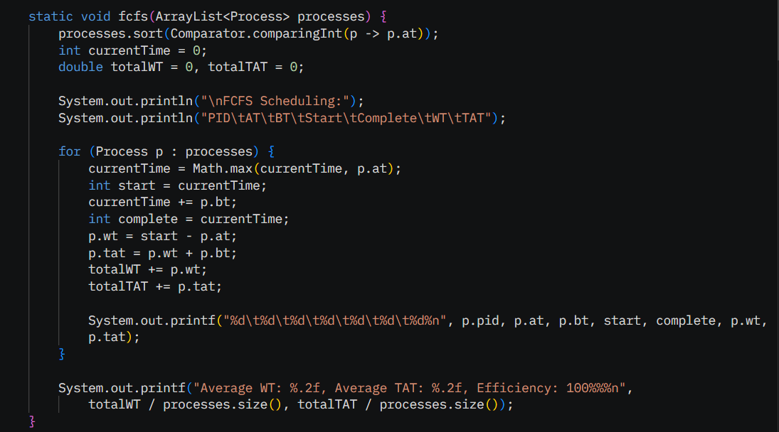
FCFS (First Come First Serve)
Data Structure Used: ArrayList<Process>
Stores processes in dynamic order of arrival.
Sorted by Arrival Time (AT) using .sort() function.
Sequential iteration simulates “first-come” execution.
Why ArrayList? Efficient for index-based iteration and dynamic resizing when processes are entered.

Slide 7
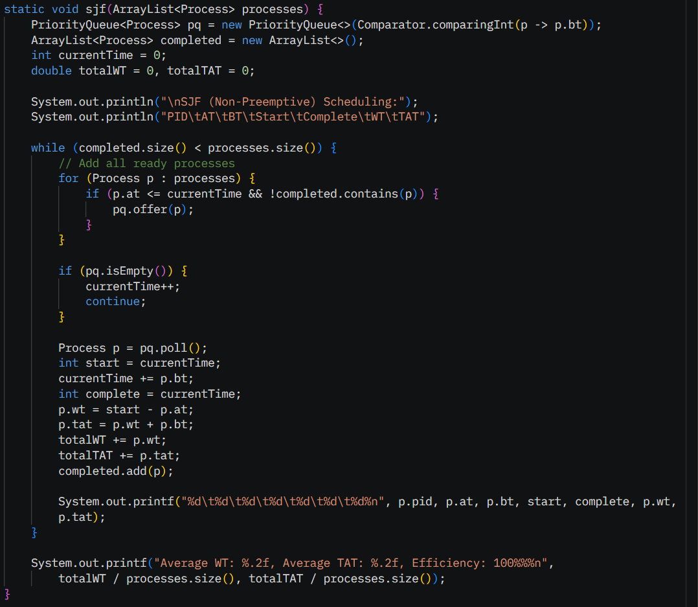
SJF(Shortest job first)
Data Structures Used:
ArrayList<Process> processes → Stores all processes with their Arrival Time (AT) and Burst Time (BT).
PriorityQueue<Process> pq → Holds all ready processes, automatically sorted by shortest BT.
ArrayList<Process> completed → Stores completed processes for calculating statistics.
Logic / Steps:
Initialize currentTime = 0.
Add all ready processes (AT ≤ currentTime and not completed) to pq.
If pq is empty, increment currentTime.
Else, pick process p from pq (shortest BT).
Execute p:
Start Time = currentTime
Complete Time = currentTime + BT
Calculate:
WT = Start − AT
TAT = WT + BT
Add p to completed and update totalWT and totalTAT.
Repeat until all processes are completed.

Slide 8
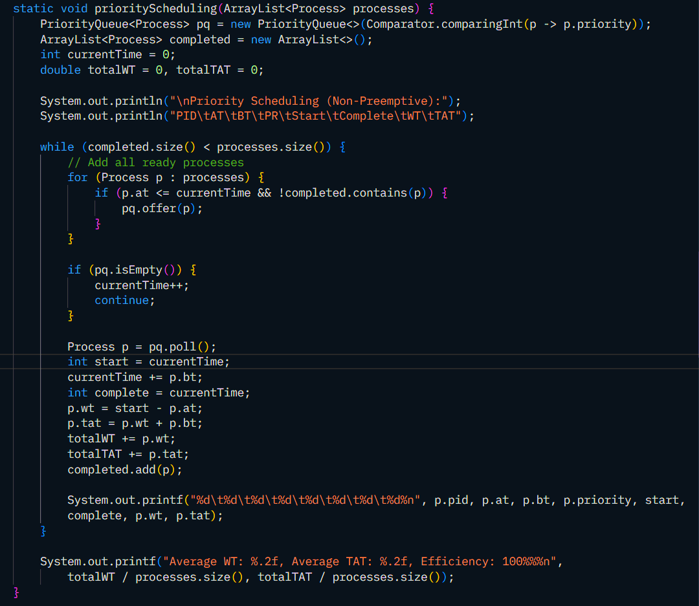
Priority Scheduling (Non – Preemptive)
Data Structures Used:
ArrayList<Process> processes → Stores all process details (PID, AT, BT, Priority).
PriorityQueue<Process> pq → Holds all ready processes, automatically sorted by priority value.
ArrayList<Process> completed → Keeps record of all completed processes to calculate averages.
Logic:
At each time step, select all ready processes (AT ≤ currentTime).
Pick the process with highest priority from ready queue.
Execute it, calculate WT and TAT, and mark it as completed.
Repeat until all processes are done.

Slide 9
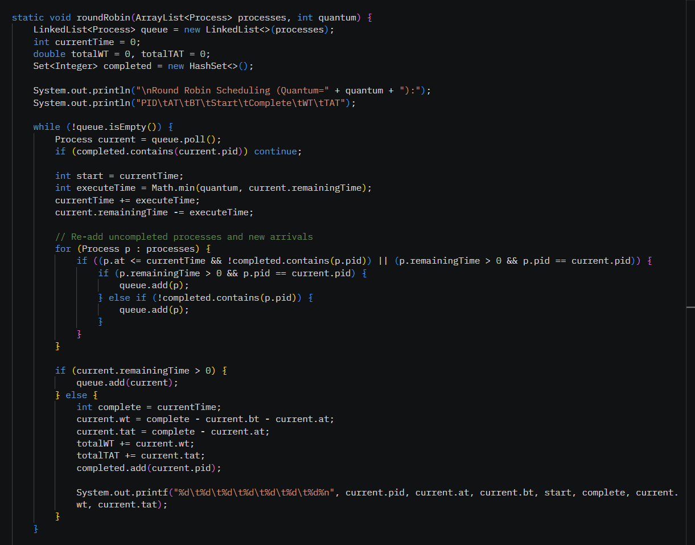

Round Robin
Logic (Round Robin):
Run each process for a fixed quantum, updating current time and remaining burst.
Requeue unfinished processes until all are completed, then calculate WT & TAT.
Data Structures Used & Why:
LinkedList<Process> queue → Efficiently handles FIFO execution of processes.
ArrayList<Process> processes → Stores all processes for checking new arrivals.
HashSet<Integer> completed → Tracks completed PIDs to avoid re-processing.

Slide 10

Output
Sample Input
Using the dataset from Table 1.1 in your report (4 processes):
PID | AT (Arrival Time) | BT (Burst Time) | PR (Priority)
1 | 0 | 5 | 2
2 | 1 | 3 | 1
3 | 2 | 8 | 3
4 | 3 | 6 | 4

Slide 11
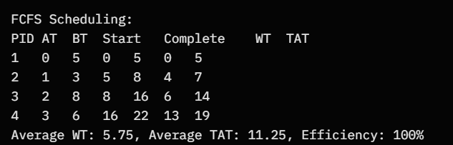
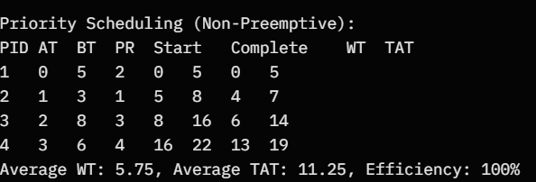
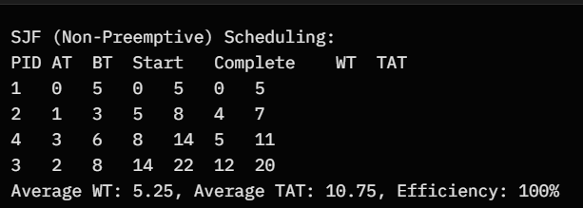
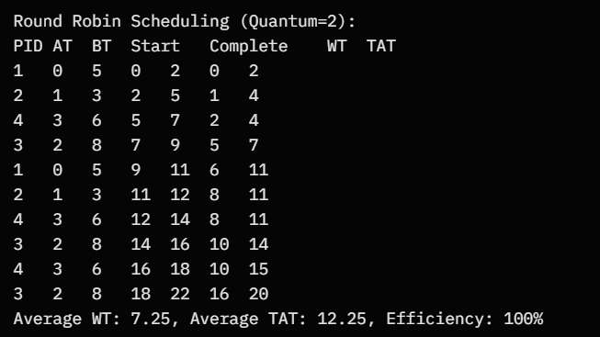
fcfs
Priority
SJF
Round robin

Slide 12
Thank you

